Slide 1
Paging in OS

Slide 2
Paging in OS
In Operating Systems, Paging is a storage mechanism used to retrieve processes from the secondary storage into the main memory in the form of pages.
The main idea behind the paging is to divide each process in the form of pages. The main memory will also be divided in the form of frames.
One page of the process is to be stored in one of the frames of the memory. The pages can be stored at the different locations of the memory but the priority is always to find the contiguous frames or holes.
Pages of the process are brought into the main memory only when they are required otherwise they reside in the secondary storage.

Slide 3
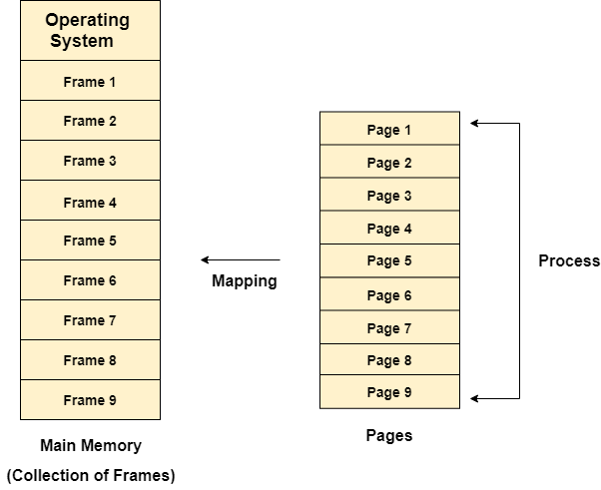

Slide 4
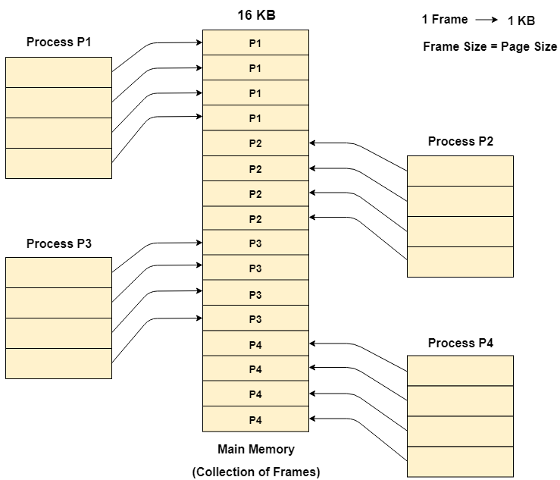
Example
Let us consider the main memory size 16 Kb and Frame size is 1 KB therefore the main memory will be divided into the collection of 16 frames of 1 KB each.
There are 4 processes in the system that is P1, P2, P3 and P4 of 4 KB each. Each process is divided into pages of 1 KB each so that one page can be stored in one frame.
Initially, all the frames are empty therefore pages of the processes will get stored in the contiguous way.
Frames, pages and the mapping between the two is shown in the image below.

Slide 5
Page Replacement Algorithms in Operating Systems
In an operating system that uses paging for memory management, a page replacement algorithm is needed to decide which page needs to be replaced when a new page comes in. Page replacement becomes necessary when a page fault occurs and there are no free page frames in memory. However, another page fault would arise if the replaced page is referenced again. Hence it is important to replace a page that is not likely to be referenced in the immediate future. If no page frame is free, the virtual memory manager performs a page replacement operation to replace one of the pages existing in memory with the page whose reference caused the page fault.

Slide 6
Page Replacement Algorithms in Operating Systems
Page Fault: A page fault happens when a running program accesses a memory page that is mapped into the virtual address space but not loaded in physical memory. Since actual physical memory is much smaller than virtual memory, page faults happen. In case of a page fault, Operating System might have to replace one of the existing pages with the newly needed page. Different page replacement algorithms suggest different ways to decide which page to replace. The target for all algorithms is to reduce the number of page faults.

Slide 7
Page Replacement Algorithms:
1. First In First Out (FIFO): This is the simplest page replacement algorithm. In this algorithm, the operating system keeps track of all pages in the memory in a queue, the oldest page is in the front of the queue. When a page needs to be replaced page in the front of the queue is selected for removal.

Slide 8
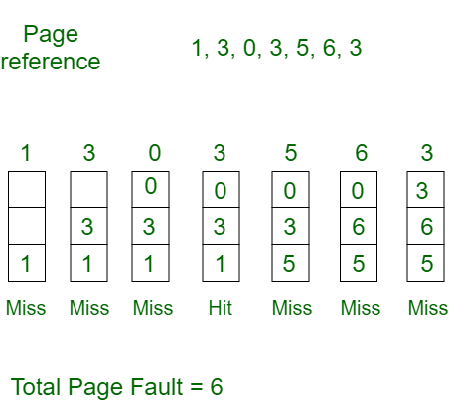
Example
Consider page reference string 1, 3, 0, 3, 5, 6, 3 with 3 page frames.Find the number of page faults.

Slide 9
Explanation
Initially, all slots are empty, so when 1, 3, 0 came they are allocated to the empty slots —> 3 Page Faults. when 3 comes, it is already in memory so —> 0 Page Faults. Then 5 comes, it is not available in memory so it replaces the oldest page slot i.e 1. —>1 Page Fault. 6 comes, it is also not available in memory so it replaces the oldest page slot i.e 3 —>1 Page Fault. Finally, when 3 come it is not available so it replaces 0 1 page fault.

Slide 10
Belady’s anomaly Problem
Belady’s anomaly proves that it is possible to have more page faults when increasing the number of page frames while using the First in First Out (FIFO) page replacement algorithm. For example, if we consider reference strings 3, 2, 1, 0, 3, 2, 4, 3, 2, 1, 0, 4, and 3 slots, we get 9 total page faults, but if we increase slots to 4, we get 10-page faults.

Slide 11
In the case of LRU and optimal page replacement algorithms, it is seen that the number of page faults will be reduced if we increase the number of frames. However, Balady found that, In FIFO page replacement algorithm, the number of page faults will get increased with the increment in number of frames.
This is the strange behavior shown by FIFO algorithm in some of the cases. This is an Anomaly called as Belady'sAnomaly.
Let's examine such example :
The reference String is given as 0 1 5 3 0 1 4 0 1 5 3 4. Let's analyze the behavior of FIFO algorithm in two cases.

Slide 12
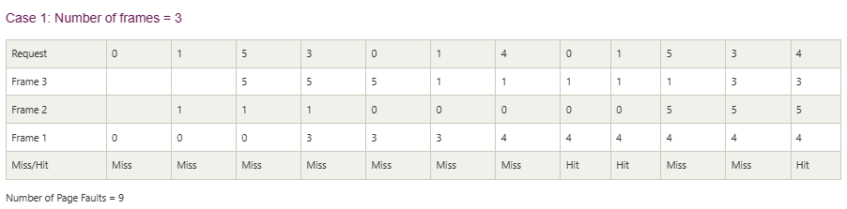

Slide 13
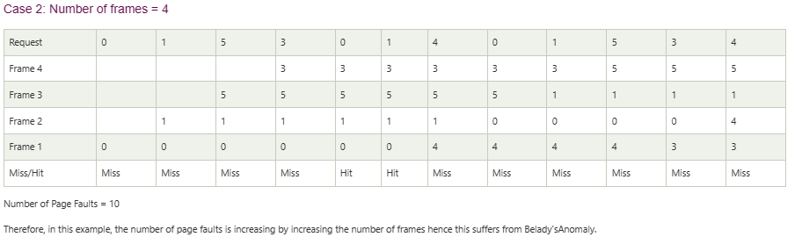

Slide 14
2. Optimal Page replacement
Optimal Page replacement: In this algorithm, pages are replaced which would not be used for the longest duration of time in the future.

Slide 15
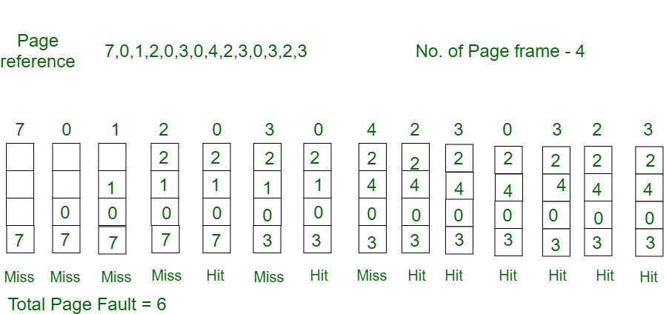
2. Optimal Page replacement
Example: Consider the page references 7, 0, 1, 2, 0, 3, 0, 4, 2, 3, 0, 3, 2, 3 with 4 page frame. Find number of page fault.

Slide 16
Explaination
Initially, all slots are empty, so when 7 0 1 2 are allocated to the empty slots —> 4 Page faults 0 is already there so —> 0 Page fault. when 3 came it will take the place of 7 because it is not used for the longest duration of time in the future.—>1 Page fault. 0 is already there so —> 0 Page fault. 4 will takes place of 1 —> 1 Page Fault.
Now for the further page reference string —> 0 Page fault because they are already available in the memory. Optimal page replacement is perfect, but not possible in practice as the operating system cannot know future requests. The use of Optimal Page replacement is to set up a benchmark so that other replacement algorithms can be analyzed against it.

Slide 17
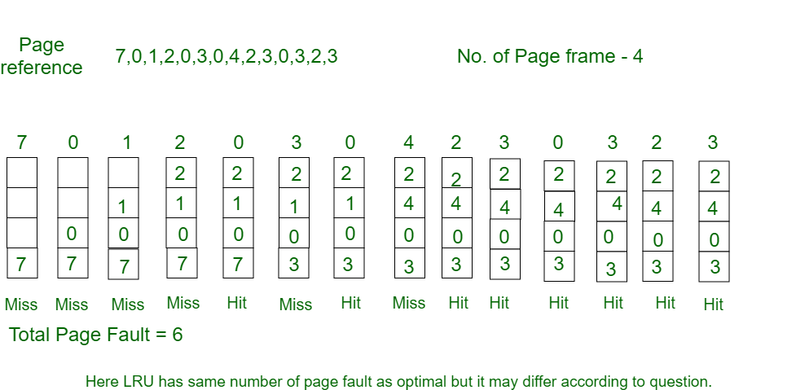
3. Least Recently Used
3. Least Recently Used: In this algorithm, page will be replaced which is least recently used.
Example-3: Consider the page reference string 7, 0, 1, 2, 0, 3, 0, 4, 2, 3, 0, 3, 2, 3 with 4 page frames. Find number of page faults.

Slide 18
Explaination
Initially, all slots are empty, so when 7 0 1 2 are allocated to the empty slots —> 4 Page faults 0 is already their so —> 0 Page fault. when 3 came it will take the place of 7 because it is least recently used —>1 Page fault 0 is already in memory so —> 0 Page fault. 4 will takes place of 1 —> 1 Page Fault Now for the further page reference string —> 0 Page fault because they are already available in the memory.

Slide 19
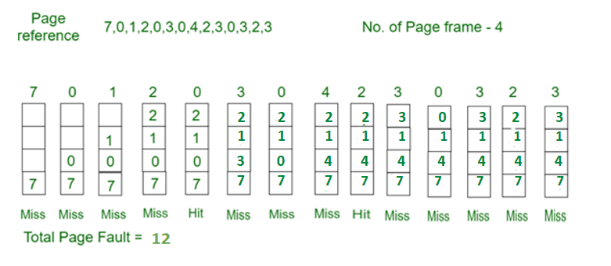
4. Most Recently Used (MRU)
4. Most Recently Used (MRU): In this algorithm, page will be replaced which has been used recently. Belady’s anomaly can occur in this algorithm.

Slide 20
Explaination
Initially, all slots are empty, so when 7 0 1 2 are allocated to the empty slots —> 4 Page faults
0 is already their so–> 0 page fault
when 3 comes it will take place of 0 because it is most recently used —>1 Page fault
when 0 comes it will take place of 3 —>1 Page fault
when 4 comes it will take place of 0 —>1 Page fault
2 is already in memory so —> 0 Page fault
when 3 comes it will take place of 2 —>1 Page fault
when 0 comes it will take place of 3 —>1 Page fault
when 3 comes it will take place of 0 —>1 Page fault
when 2 comes it will take place of 3 —>1 Page fault
when 3 comes it will take place of 2 —>1 Page fault

